Slide 1





The Evolution of Facebook 2011-2021
The Society

Slide 2


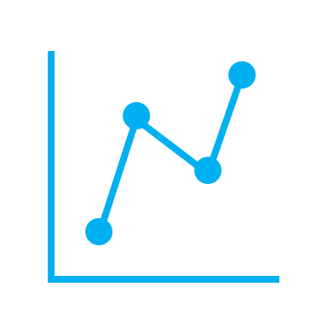

The Attributes of Our Data
Engagement
Trends
Time
[4]

Slide 3

The Goals of our Data
We want to explore what statistic relates to the number of likes, time a user has spent on the platform, and gender. We are trying to explore which of these areas is most likely going to influence whether and user will have increased traffic to their profile and postings. At the end of our research and after cleaning our dataset, we hope to prove whether time, age, or gender have an influence on your presence on Facebook.
*These metrics are based off personal datasets

Slide 4

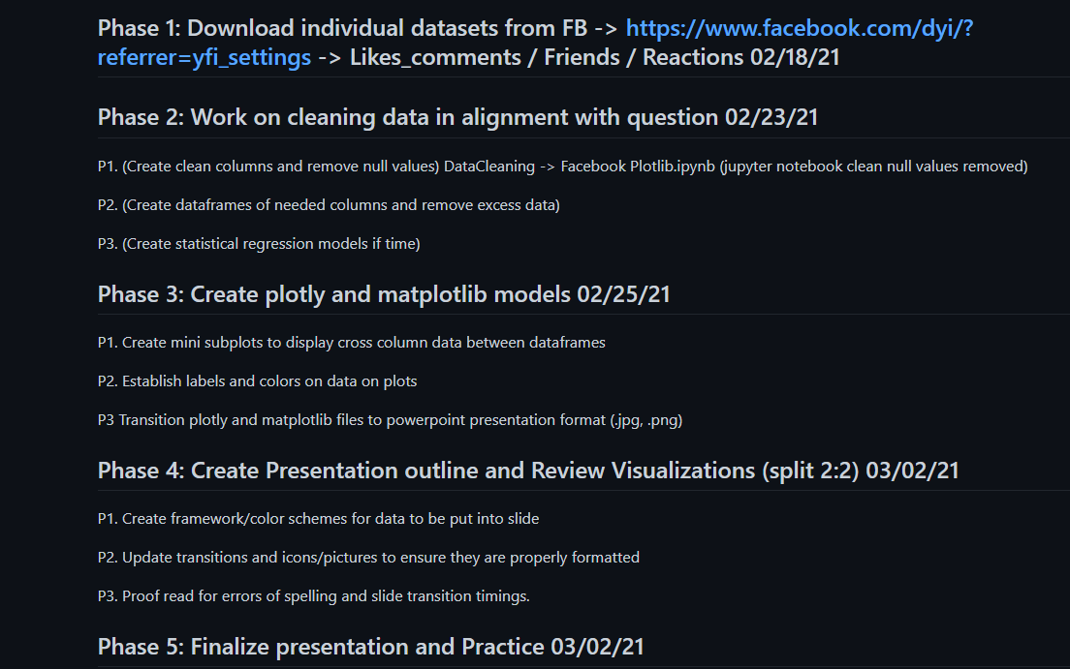
Dataset Foundation and Processes

Slide 5
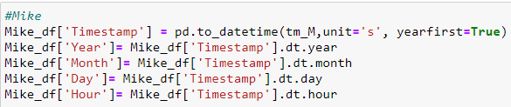
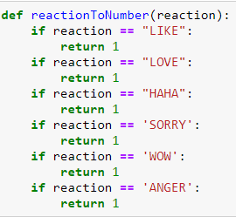
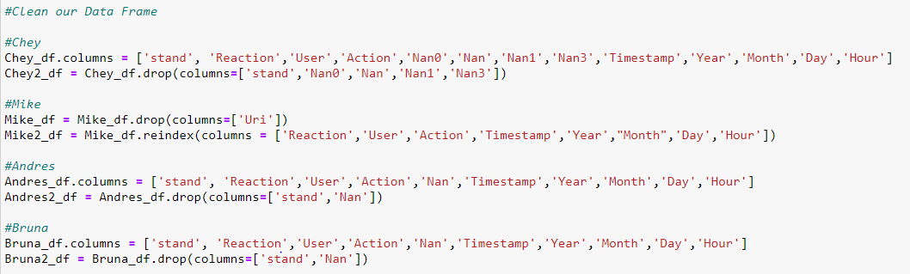
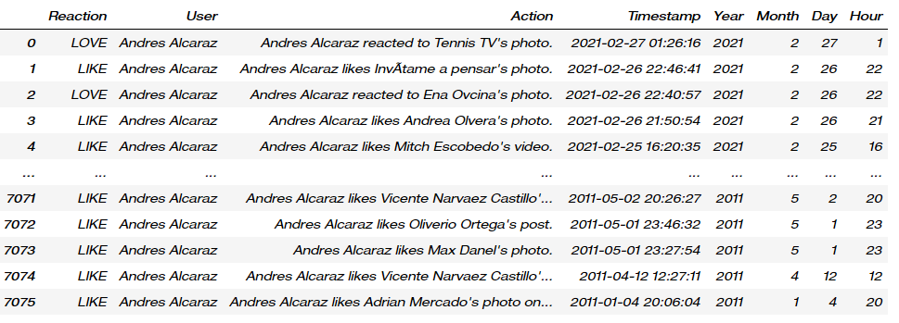
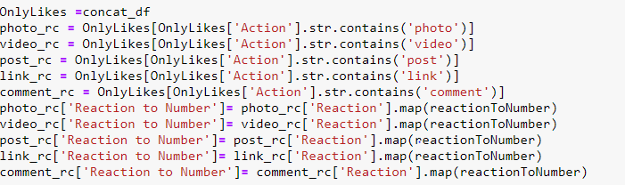
Cleaning Our Data

Slide 6


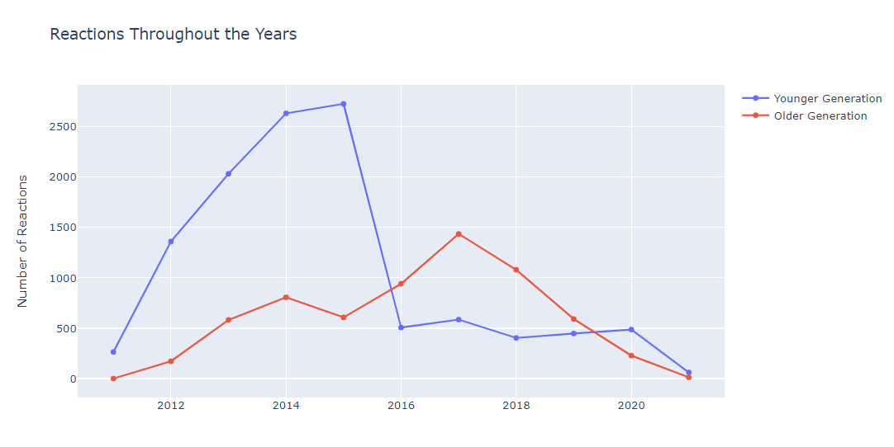
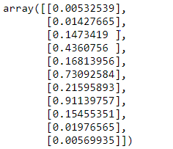
Hypothesis:
The older generation uses more reactions.
Question:
Which Generation reacted the most over time?

Slide 7

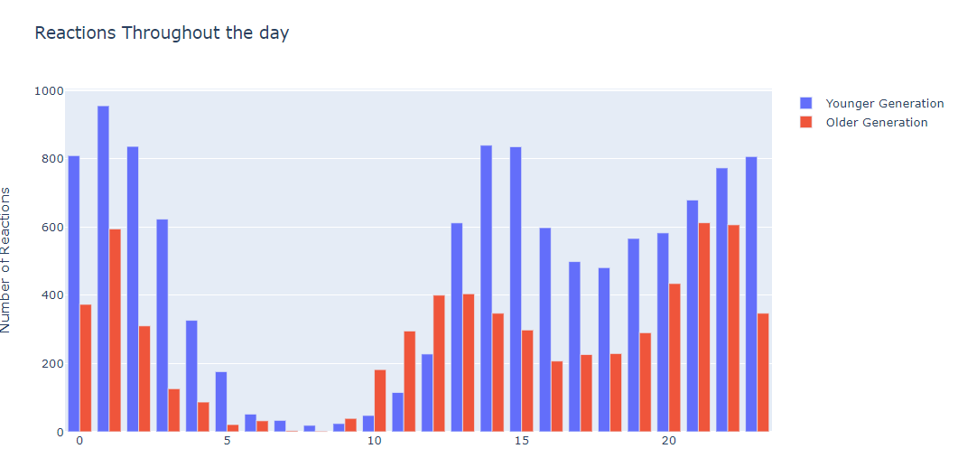
Hypothesis:
The time you post affects your likes.
Question:
Does the time you post affect how many likes your post will get?

Slide 8


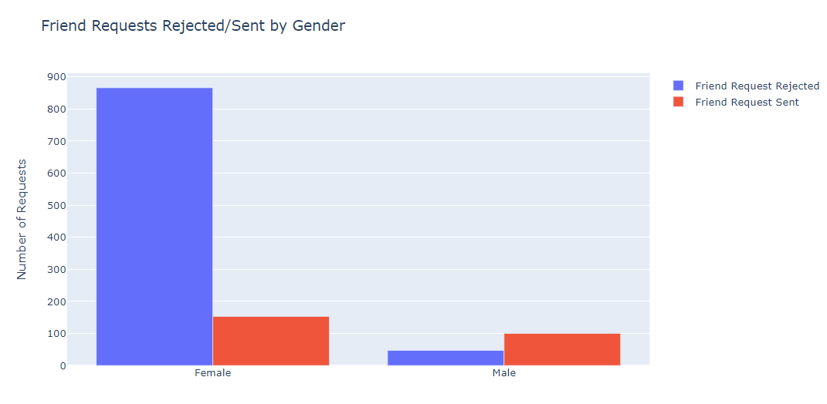
Hypothesis:
Males send more friend request.
Females reject more friend request
Question:
Which gender sends and rejects the most friend request?

Slide 9

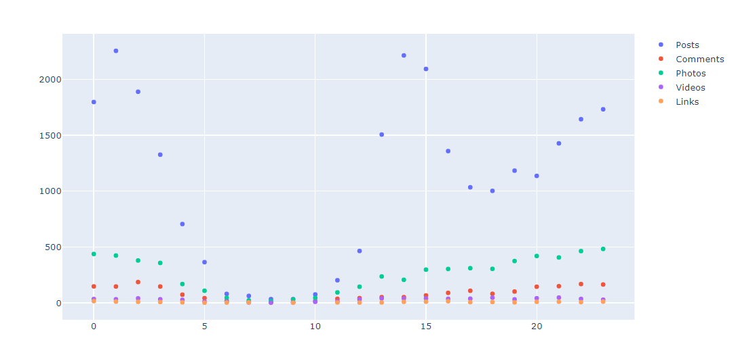
Hypothesis:
Posts will get the most reactions
Reaction Type by Post
Question:
Which post type generates the most reactions?

Slide 10
QUESTIONS?

